Slide 1


Business Intelligence (BI)
Name - Abdul Hadi (123111347)
Muhammad Altamash (123116091)
Russel Mondayapurath (123115296)
Siddhant Mishra (123100424)
Lecturer - Dr. Sheila O’Riordan

Slide 2

KEY
FINDINGS

Slide 3
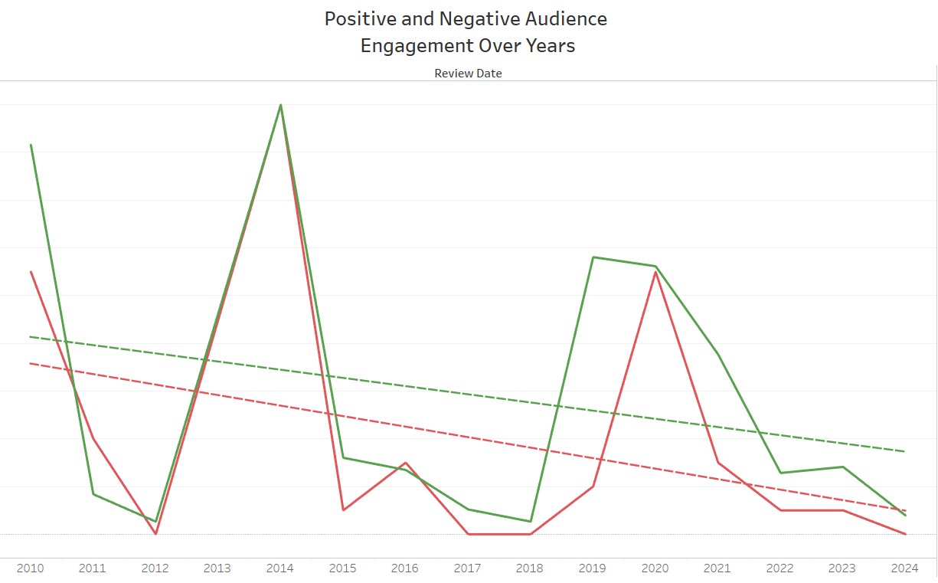
Audience Trends Analysis
Identify Audience Trends:
Monitoring the overall sentiment trends enables a deeper understanding of audience reactions and preferences over time. This information can be utilized to inform future content creation and marketing strategies.
Spot Potential Turning Points:
By closely observing significant shifts in sentiment trends, particularly those coinciding with specific events or movie releases, opportunities can be identified to capitalize on positive sentiment trends and address concerns during periods of negative sentiment.

Slide 4
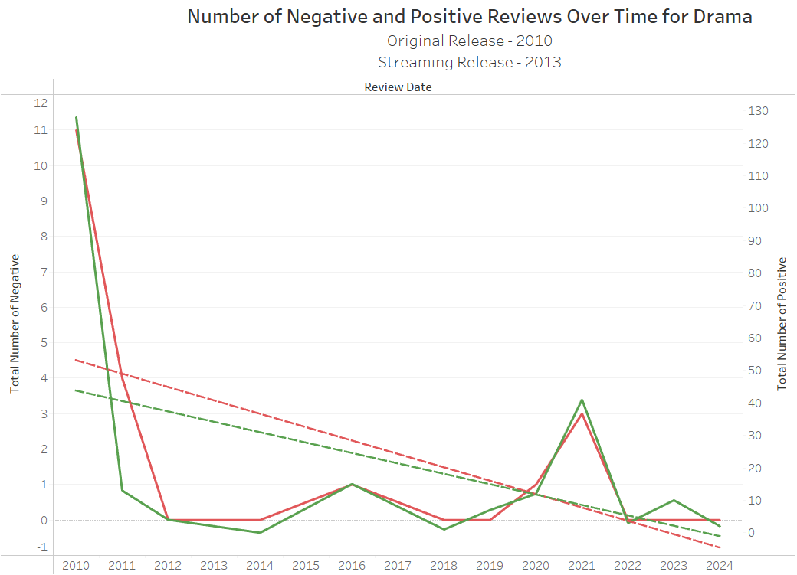
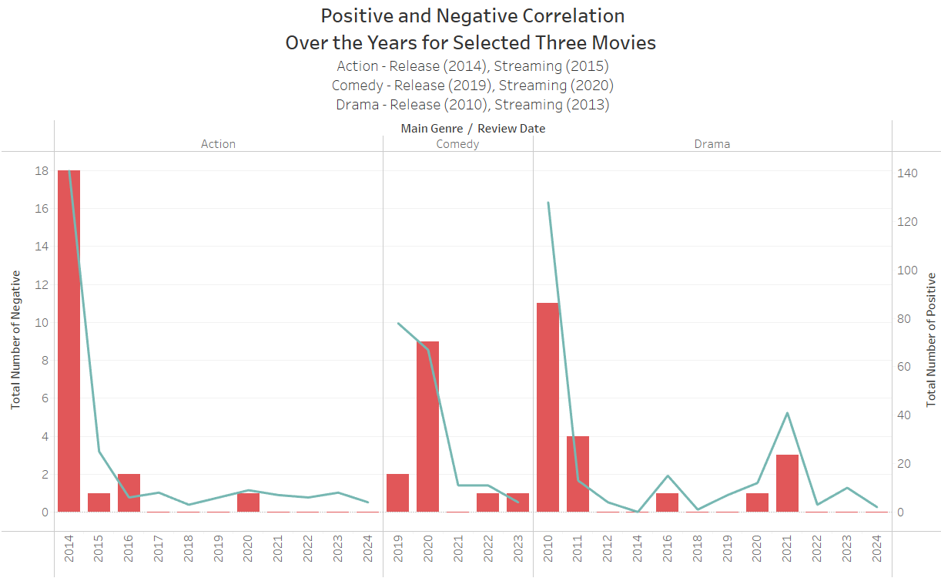
Positive & Negative Audience Engagement Over Years
Audience Engagement Trends:
Analyzing the audience trend from 2010 to 2024 reveals that both negative and positive reviews peaked during the streaming release and the COVID-19 pandemic period, when a larger and newer audience started watching old movies (released in 2010). Moreover, negative reviews stabilized during the post-pandemic period, while positive reviews varied.
Impact of Lead Actor's Achievements:
The peak in negative and positive audience engagements for old movies coincides with lead actor Leonardo DiCaprio winning the Best Actor Oscar in 2016.

Slide 5
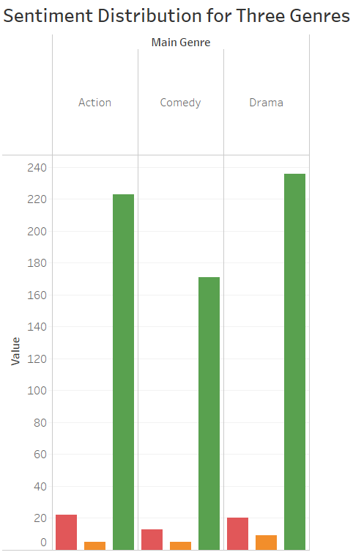
Sentiment Distribution for Three Genres
Audience Preference by Genre:
Identify which genres elicit the highest proportion of positive sentiment. Focus on producing content within these genres to maximize audience satisfaction and engagement.
Genre-Specific Challenges:
Recognize any disparities in sentiment distribution across genres, indicating potential challenges or opportunities for improvement in content creation or marketing strategies.
Content Strategy Alignment:
Align content creation efforts with audience sentiment preferences for each genre. Emphasize genres with a higher proportion of positive sentiment in future production planning and investment decisions.
Continuous Genre Analysis:
Continuously monitor sentiment distribution trends across genres to adapt strategies and remain responsive to shifting audience preferences and market dynamics.

Slide 6
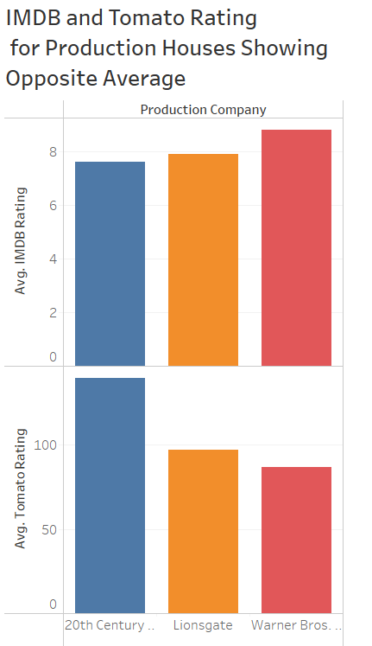
IMDB & Tomato Rating for Production Houses Showing Opposite Average
Leverage Strengths in Marketing:
Highlight Warner Bros. productions to IMDB users and the general audience, emphasizing positive ratings and audience appeal. For Rotten Tomato critics' preference, focus on showcasing Lionsgate and 20th Century Fox productions, highlighting critical acclaim and review scores.
Diversify Content Strategy:
Consider diversifying content partnerships and collaborations across production houses to cater to both IMDB user preferences and Rotten Tomato critic preferences. This approach can help broaden audience reach and appeal across different platforms and demographics.
Targeted Promotional Campaigns:
Tailor promotional campaigns to specific audience segments based on their preferred rating platforms. Craft marketing messages that resonate with the preferences of IMDB users for Warner Bros. productions and Rotten Tomato critics for Lionsgate and 20th Century Fox productions.

Slide 7
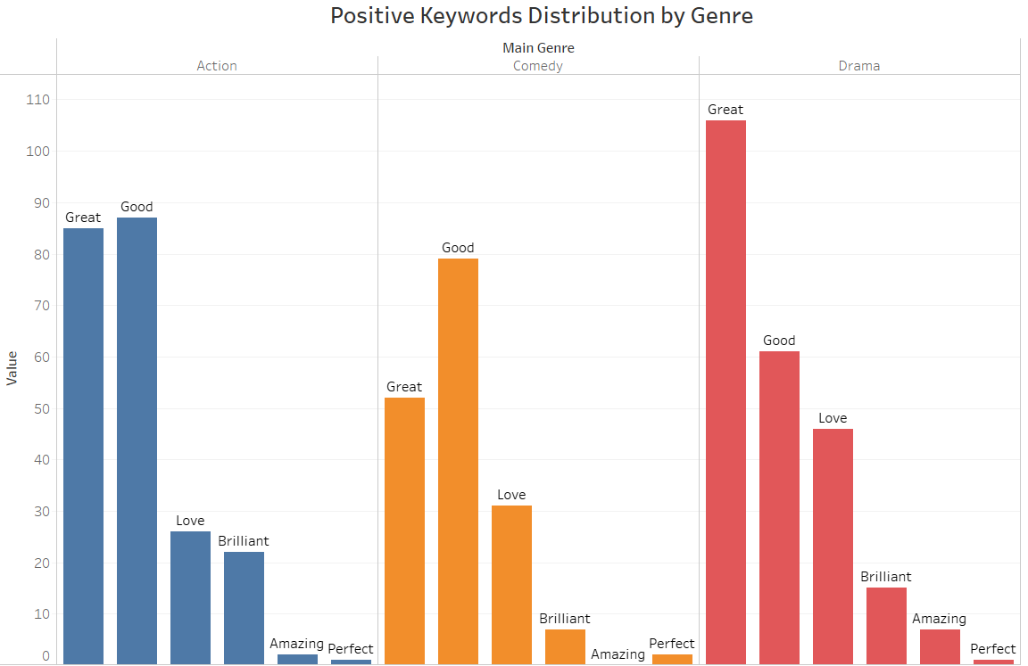
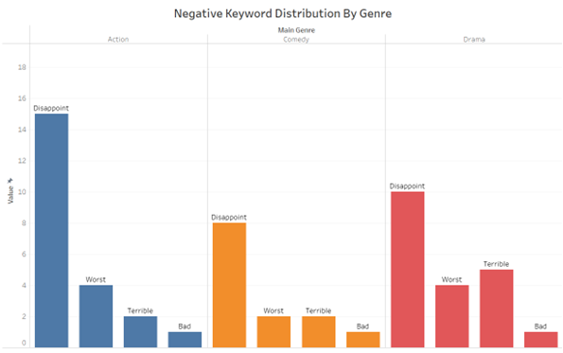
Positive & Negative Keyword Distribution by Genre
Analyze Positive Keywords:
By identifying the most commonly used positive keywords associated with movies of different genres, the production house can uncover themes, elements, and characteristics that resonate well with audiences. This analysis enables the prioritization of acquiring the rights to movies that align with these positive sentiments.
Understand Negative Keywords:
Examining the negative keywords used to describe movies allows the production house to avoid acquiring the rights to films with less favored elements. By understanding these negative sentiments, the production house can reduce the risk of investing in underperforming projects.
Minimize Potential Risks:
Utilizing negative keyword research helps the production house avoid acquiring the rights to movies that may face backlash or underperform due to audience aversion to certain elements. This proactive approach mitigates financial risks and optimizes return on investment.

Slide 8

Recommendations
To maximize audience engagement and satisfaction, Salt Productions should carefully consider release timing and streaming availability. By analyzing audience sentiment around original and streaming release dates, Salt Productions can optimize release strategies. Identifying critical events and continuously monitoring evolving audience sentiment trends will help Salt Productions adapt its strategies effectively. To align content creation efforts with audience preferences, Salt Productions should focus on producing content within genres that elicit the highest proportion of positive sentiment. Continuous genre analysis will allow Salt Productions to emphasize genres with more positive sentiment in future production planning and investment decisions.
Diversifying content partnerships and collaborations across production houses will broaden audience reach and appeal across different platforms and demographics. Tailoring promotional campaigns to specific audience segments based on their preferred rating platforms is also crucial for Salt Productions' success.
Analyzing positive and negative keywords associated with movies of different genres will provide insights into audience preferences and help Salt Productions optimize its content acquisition strategy, minimizing potential risks and maximizing return on investment.

Slide 9
Conclusion
Enhancing content production, marketing tactics, and movie rights acquisition can be achieved by analysing several aspects of audience interaction, genre preferences, ratings, and keyword research. These analyses offer significant information.
Production companies can customise their content to optimise audience pleasure and engagement by identifying genre-specific preferences, utilising the power of lead performers, and understanding audience patterns. Additionally, focused advertising efforts that appeal to various audience segments are made possible by the use of ratings in marketing techniques.
Production companies can reduce risks and maximise return on investment by prioritising films that correlate with positive audience attitudes and avoiding those connected with negative keywords by incorporating keyword research into their movie rights acquisition strategy. Production companies can maintain long-term success in the ever-changing entertainment sector by keeping an eye on trends and modifying their tactics in response to audience preferences and changing market conditions.

